Slide 1

Basic network design
Customer needs
1
1 Router - C926-4P ISR
2
1 switch - CBS350-8FP-2G
3
2 Wireless AP
4
2 Firewall
5
3 Desktop Computers - Windows
6
4 laptops Computer

Slide 2

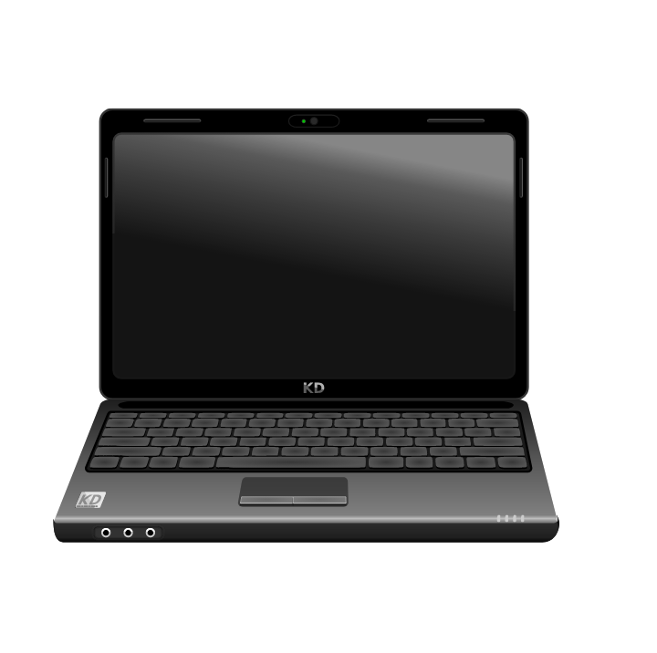
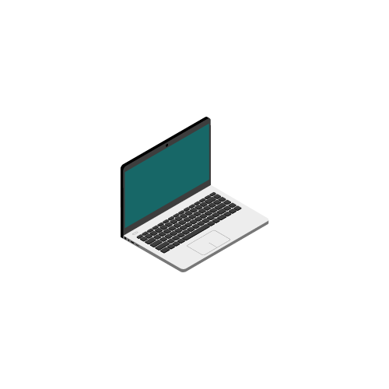
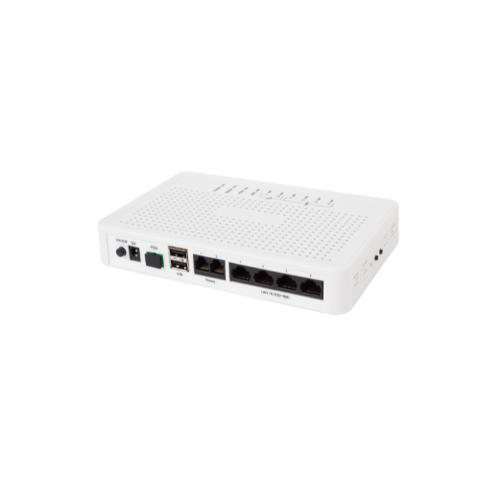


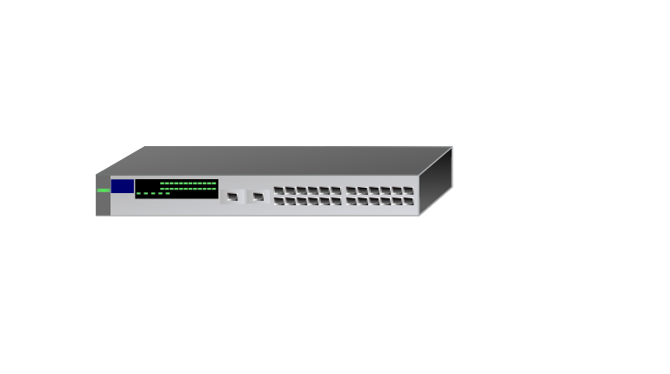
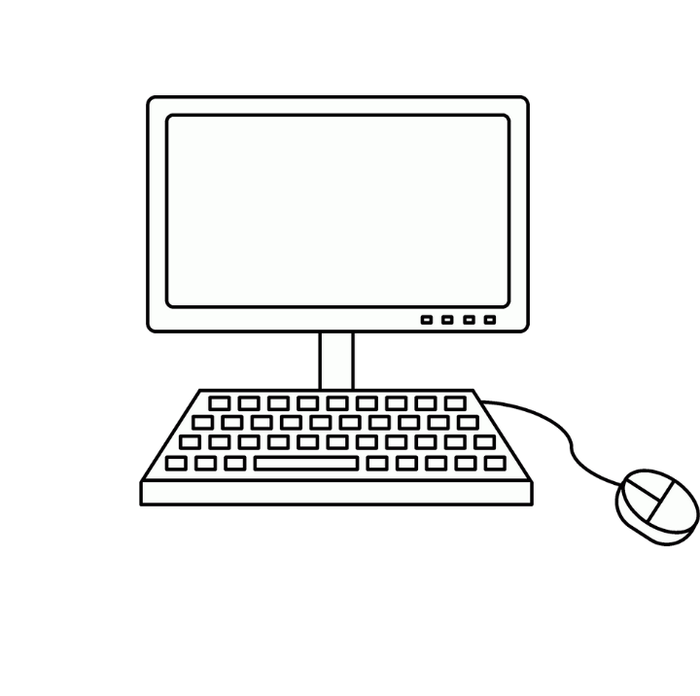
Basic network design
What is a Router
A router is a device that routes or forwards data from one network to another based on their IP address. When a data packet is received from the router, the router inspects the data’s IP address. If the router determines that the data packet is meant for its own network it receives it, but if it's not meant for its own network, it sends it off to another Network
Router
Switchers
Packet accepted

Slide 3
Basic network design
What is a Switch
A switch is a hardware that connects devices on a computer network by using packet switching. A switch is intelligent, it can learn the physical addresses of the devices connected to it, and it stores these physical addresses called Mac addresses in its table, so that when a data packet is sent to a switch, it is only directed to its intended destination.
Switches are only used for exchanging data within a local network, for example in your home or company network. They are not used to exchange data outside their own network, such as over the Internet, because to exchange or route data outside their own network to another network, such as over the Internet, a device must be able to have an IP address.
Port | Device | MAC Address
PC 1 | DETECTED | 01-00-2A-CW-37
PC 2 | DETECTED | 02-00-2A-CW-37
PC 3 | DETECTED | 03-00-2A-CW-37
PC4 | DETECTED | 04-00-2A-CW-37

Slide 4
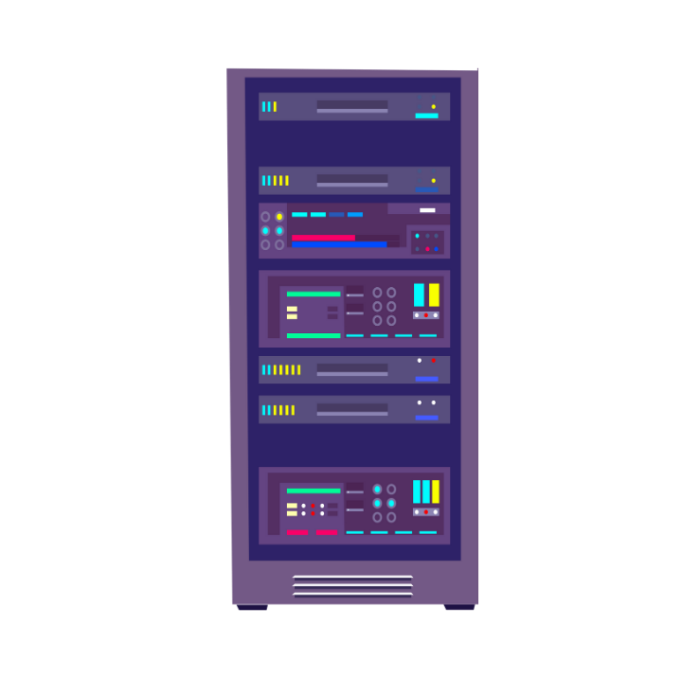
Basic network design
What is a Switch
pc1
pc2
pc4
pc4
Switch
Server
pc3
pc3

Slide 5
Basic network design
What is a Wireless Access Point
A wireless AP relays data between a wired Network and wireless devices, it's basically a wireless hub used by wireless devices to connect to an existing wired Network.
A wireless AP can connect directly to an organization's router where the router is then connected directly to a Modem which gives the wireless devices access to the internet

Slide 6


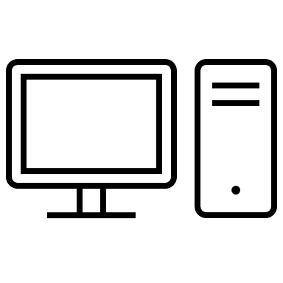



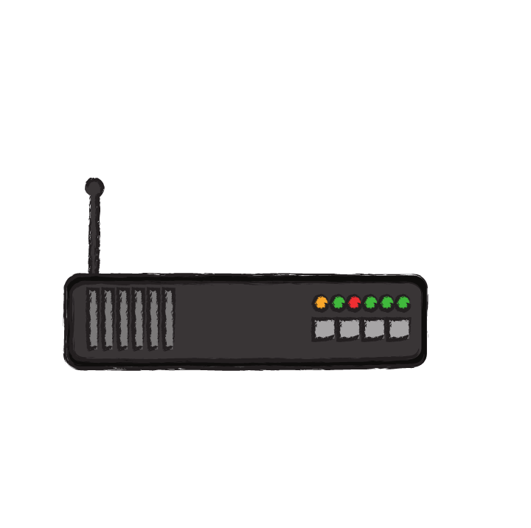



Basic network design
Wireless AP
Wireless AP
Switchers
Router

Slide 7



Basic network design
What is a Firewall
A router is a device that routes or forwards data from one network to another based on their IP address. When a data packet is received from the router, the router inspects the data’s IP address. If the router determines that the data packet is meant for its own network it receives it, but if it's not meant for its own network, it sends it off to another Network
Router
Switchers

